Slide 1
HNDIT1212: System Analysis and Design
System Development Lifecycle

Slide 2
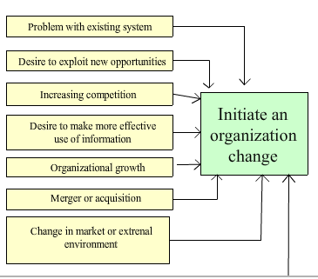
When does the development of a system begin?
New system

Slide 3
Systems Development Life Cycle (SDLC)
It is a logical process by which systems analysts, s/w engineers, programmers & end users build information systems.
Consists of several phases used to plan, execute & control the system development projects.

Slide 4
Need of a life cycle
We need a life cycle in systems development to,
ease the process of building a system
build high quality systems that meets customer expectations, within time and cost estimates
work effectively and efficiently in the current and planned information technology infrastructure
avoid failures like unclear objectives, cost overruns
maintain and enhance cost effectively

Slide 5





System Development Life Cycle (SDLC)
Problem Definition
Systems initialization
Systems Analysis
Maintenance
Systems Testing
Systems Design
Systems Implementation

Slide 6
Systems Development Life Cycle (SDLC)
Main phases of SDLC:
Problem Definition (systems Investigation)
Systems Analysis
Systems Design
Systems Implementation
Systems Testing
Systems Maintenance

Slide 7
1. Problem Definition (System Initiation)
This phase identifies and defines a need for the new system.
Project goals, project bounds & project limits are set by the organization’s management.
They are sometimes called project's Terms of Reference (TOR).

Slide 8


Terms of Reference (TOR)
Provides a broad statement of user requirements in users terms, or what the users expect the system to do
Project goals
Project bound
Defines what part of the system can be changed by the project and what parts are to remain same.
Project
limits
Specify the resources to be made available for the project (resource limits).

Slide 9

2. Requirement Analysis
how the current system works and what it does
Producing a detailed model of what the new system will do and how it will work.
Producing a high-level description of the system

Slide 10
Requirement Analysis
It specifies the system users’ business requirements, expectations and priorities for a solution to the business problem
This phase produces
a detailed analysis model describing how the current system works.
a requirements model describing what is needed from the new system in user's terms.
system requirements using system terms.

Slide 11
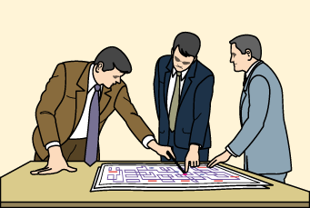
3.Systems Design
Produces a design specification for the new system.
Things done during the design phase:
Identify suitable hardware
Specify new programs or changes to existing programs
Specify new database or changes to existing database
produce detailed procedures that describe how users will use the system

Slide 12

4. System Implementation
During the systems implementation phase,
individual system components are built and tested.
user interfaces are developed and tried by users.
a database is built to store data.
data and tools are used to build the system.

Slide 13
5. System Testing
Systems Testing is recognized as an important part of quality assurance.
Individual program modules are tested by their developers.
Integration testing is done to test whether the modules can be combined.
It is important to design test cases that test all the conditions that can arise in the system input.
After testing and evaluating the results, the system is ready to be delivered to the user/client.

Slide 14
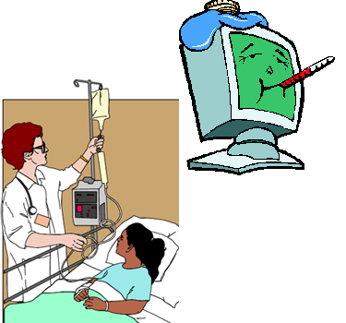
6. Maintenance
In this phase the following problems are corrected.
Eliminate errors in the system during its life time.
Fix any bugs and problems found by users
Tune the system into any variation in its working environment.
Information system planners must always plan for resource availability to carry out these maintenance functions.

Slide 15
Try!
Which stage of software development is most expensive?
Where are the most errors introduced in software projects?
What do project managers say is the worst problem (consequence) in software projects?

